Slide 1
Symbolic Toolbox in MATLAB

Slide 2
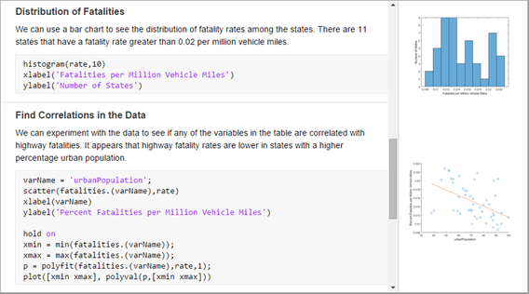
Live Script
Write, Execute, and Test code in a single interactive environment.
Run blocks of code individually.
View the results and graphics.

Slide 3
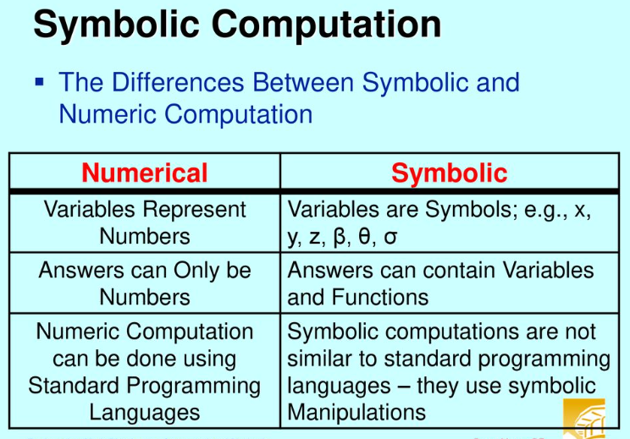
The difference between numeric & symbolic

Slide 4
Concepts
Define symbolic variables
Greek variables
Rewrite symbolic expression
Expand – Simplify
Isolate
Numden - Factor
Substitution
Calculus
Solve
Visualization
Animation

Slide 5
Why ? Symbolic toolbox
According to chatgpt
1. Exact Solutions
2. Deriving Equations of Motion
3. Parametric Studies
4. System Modeling and Simulation
5. Visualizing Solutions
6. Integration with Numeric Methods
7. Educational Insight

Slide 6
“Symbolic” toolbox allows you to:
Enter expressions in symbolic form with symbolic data types.
Expand or simplify symbolic expressions.
Find symbolic roots, limits, minima, maxima, etc.
Differentiate and integrate symbolic functions.
Solve algebraic and differential equations symbolically.
Solve simultaneous equations (even some nonlinear).
Do variable precision arithmetic.
Create graphical representations of symbolic functions.

Slide 7
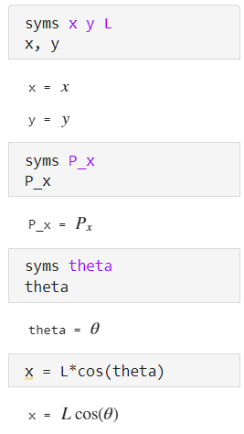
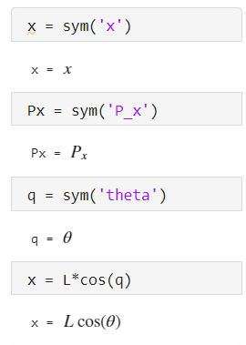
Define symbolic variables
Using >>> syms __ __ or sym(__)
Subscript
Greek letter

Slide 8
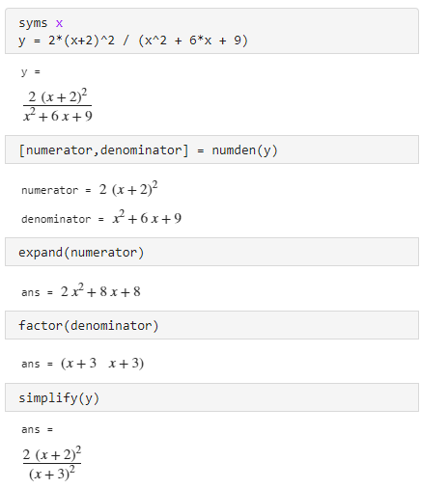
Rewrite symbolic expression
numden()
expand()
factor()
simplify()

Slide 9
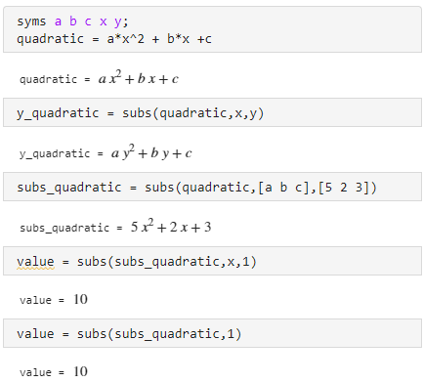
Substitution
The subs() command allows you to substitute a symbol with another symbol or assign a number to a variable.
Substitute a symbol with another symbol
Substitute a set of symbol with a set of number

Slide 10
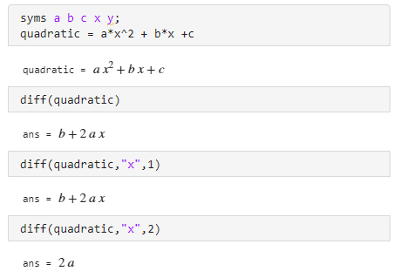
Calculus
MATLAB allows you to differentiate symbolic functions with the diff() command.

Slide 11
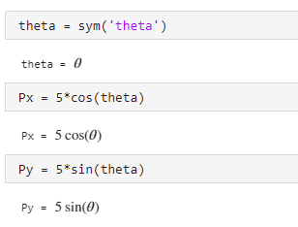
Example
Assume L = 5
Simulate this link and find path of point P

Slide 12
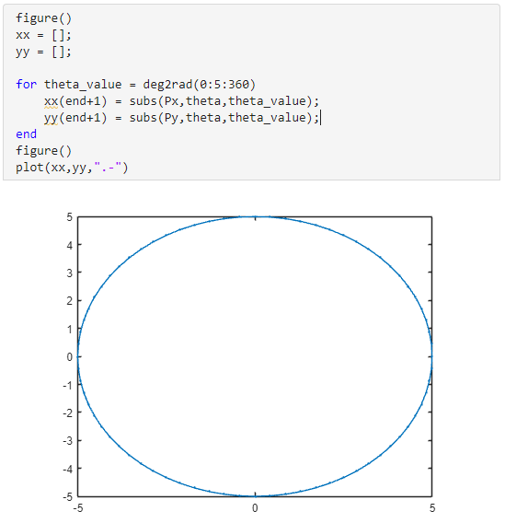
Visualization(1)
Visualize Path of point P
Using subs()
Get xx,yy in the array

Slide 13
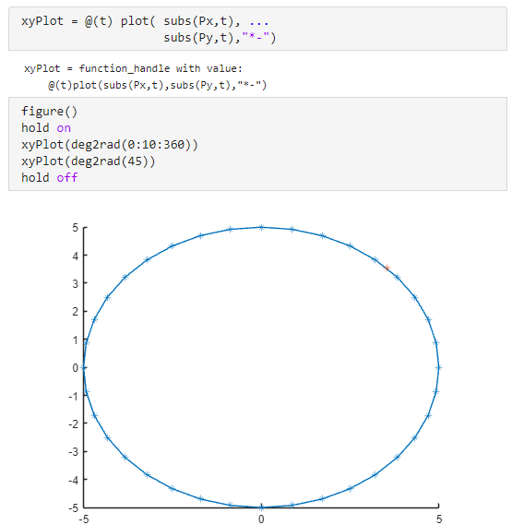
Visualization(2)
Create function handle for plot
Using @(t) to define a function handle
xyPlot = @(t) plot( subs(Px,t), subs(Py,t),"*-")

Slide 14
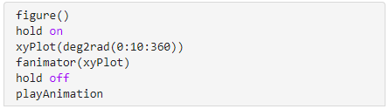
Animation
Create an animation using fanimator() with plot-function handle
To play, call playAniation
a plot-function handle

Slide 15
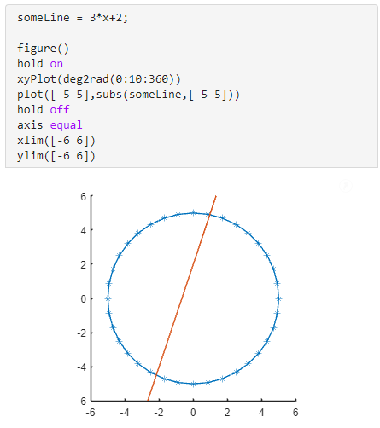
Symbolic equations
If we want to find intersection of a line to a circle, we can use symbolic math to solve it by setting equations.

Slide 16
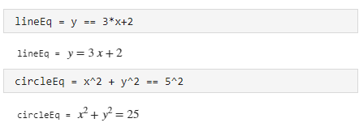
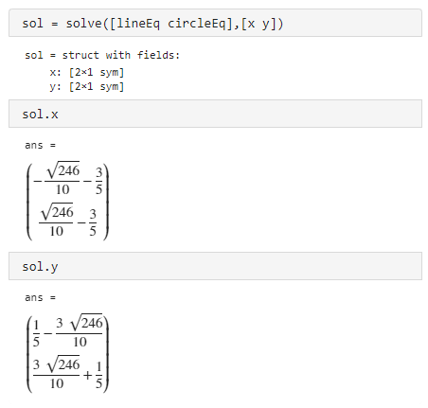
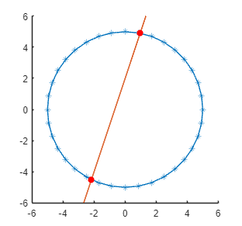
Solve
The solve(eqn,var) solve the equation eqn for the given variable var

Slide 17
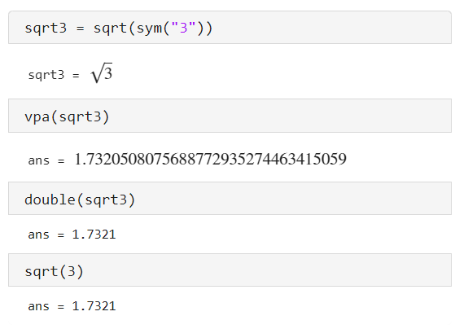
Numeric – Symbolic Interchange
sym - create symbolic variable
vpa - Variable-precision arithmetic
subs – symbolic substitution
double – cast to double precision

Slide 18
Example

Slide 19
Reference
Daniel Valentine, Symbolic Mathematics [PowerPoint slides]. https://cse.engineering.nyu.edu/~mleung/CS3113/Hahn/Lectures/lect16_symbolic_mathematics.ppt

